Slide 1




GUVI - Naan Mudhalvan
Engineering Hackathon 2025
www.guvi.in

Slide 2
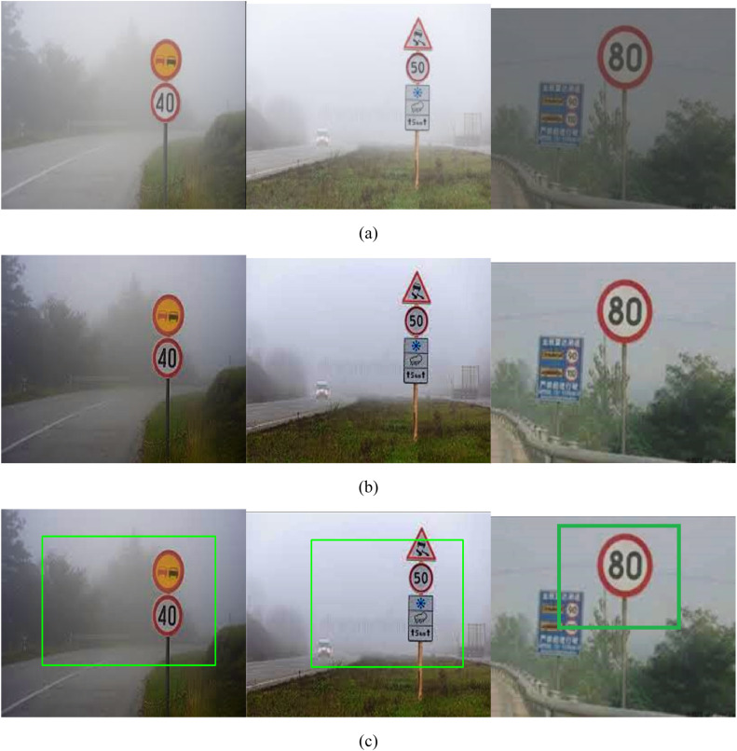
Problem Statement: Challenges in Traffic Sign Recognition
Learning Programs
Challenges in Traffic Sign Recognition
- Variability in lighting conditions
Occlusions and partial visibility
Similar-looking background objects
Need for real-time processing
www.guvi.in

Slide 3
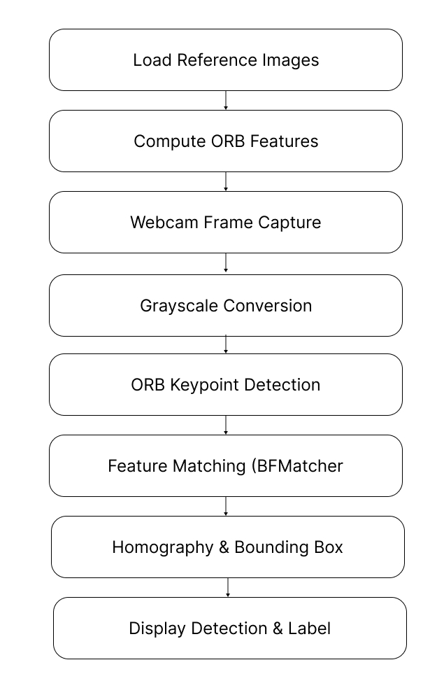
Learning Programs
Methodology and Workflow
- Image acquisition and preprocessing
Feature extraction
Object detection
Classification
www.guvi.in

Slide 4
Techniques used
Learning Programs
ORB for fast keypoint detection.
BFMatcher for feature matching.
Homography to locate signs in the frame.
Bounding boxes to visualize results
www.guvi.in

Slide 5
Learning Programs
Why This Approach?
Faster than deep learning models.
No training needed.
Works on low-end devices.
Simple and effective for real-time use.
www.guvi.in

Slide 6
Learning Programs
Applications and Future Work
Autonomous vehicles
Navigation Aid for Tourists
Traffic Monitoring
www.guvi.in

Slide 7
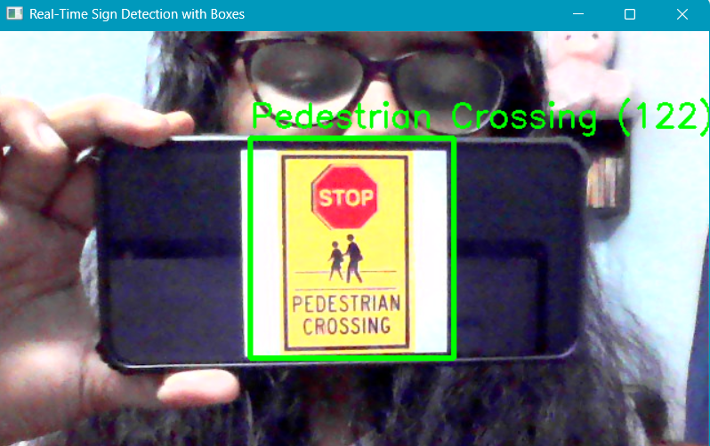
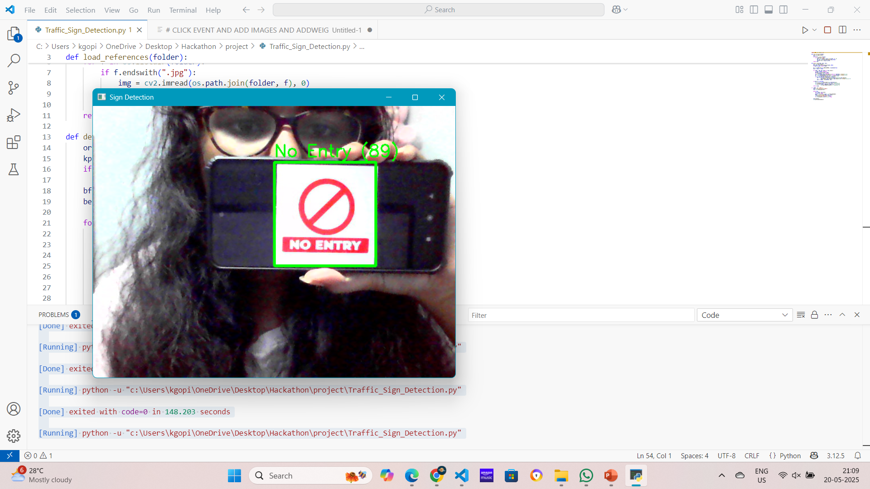
Output
Learning Programs
www.guvi.in

Slide 8
Thank You
www.guvi.in

